Slide 1
HTML - 5
Pravinkumar R.D.

Slide 2
What is HTML5?
New Markup
JavaScript API
HTML 5
+
=

Slide 3
New Elements
article figure progress
aside footer section
audio header source
Bdi main summary
canvas math svg
datalist mark time
details meter track
embed nav video
figcaption output wbr

Slide 4
article
article
<article> </article>

Slide 5
Article - W3C Specification
The article element represents a component of a page that consists of a self-contained composition in a document, page, application, or site and that is intended to be independently distributable or reusable, e.g. in syndication. This could be a forum post, a magazine or newspaper article, a blog entry, a user-submitted comment, an interactive widget or gadget, or any other independent item of content.

Slide 6
Using article tag
You should use article tag when you are –
Posting an independent item in a web page
For Example – a Magazine or News article, Blog Entry, User submitted comment, an interactive Gadget, static pages like About
You can use <section> element in <article> to split the contents of article into logical groups of contents

Slide 7
Difference between Article, Section and Div
<article> element has more semantic meaning
<section> element is only a block of related contents
<div> is only a block of contents
The pubdate attribute can not be used with <section>
If the contents make sense on its own, use <article>
If related contents, use <section>
If there is no semantic relationship, use <div>

Slide 8
aside
aside
<aside> </aside>

Slide 9
Use <aside> when
When used within an article element, the contents should be specifically related to that article
When used outside of an article element, the contents should be related to the site

Slide 10
audio, video
<video>
<source src=“lake.mp4”>
<source src=“lake.ogv”>
<source src=“lake.webm”>
<track
kind=“subtitles”
label=“English Subtitles”
src=“en.tt”
srclang=“en”>
</video>
audio
source
track

Slide 11
<audio> details
Chrome 3+ supports .ogg and .wav
Firefox 3.5+ supports .ogg and .wav
Opera 10.5+ supports .ogg and .wav
Safari 4+ supports .mp3 and .wav

Slide 12
bdi - Bidirectional Text Formatting
bdi
<bdi>˧Ⱶ</bdi>

Slide 13
canvas
canvas
<canvas></canvas>

Slide 14
datalist
datalist
<input type=“text” list=“colors”>
<datalist id=“colors”>
<option src=“Blue”>
<option src=“Red”>
</datalist>

Slide 15
details, summary
details
summary
<details>
<summary>Show Me</summary>
<p>WelCome To HTML5 </p>
</ details>

Slide 16
embed
embed
<embed src=“intro.swf”>

Slide 17
figure, figcaption
figure
figcaption
<figure>
<img src=“screen.png”>
</figure>
<figcaption>
screen of sweetdish
</figcaption>

Slide 18
header, footer
header
footer
<header></header>
<footer></footer>

Slide 19
main
main
<main></main>

Slide 20
math
math
<math>
math elements
</math>

Slide 21
mark
mark
<mark>
This text is a highlighted text.
</mark>

Slide 22
meter
meter
<meter
min=“0”
max=“100”
value=“70”>70 out of 100</meter>

Slide 23
nav
nav
<nav></nav>

Slide 24
output
output
<output></output>

Slide 25
progress
progress
<progress value=“50” max=“0”>
</progress>

Slide 26
section
section
<section></section>

Slide 27
Using section tag
You should use section tag, when –
The theme of each section you want to be identified, typically by including a heading (h1-h6 element) as a child of the section element
Section is not meant for styling or scripting. You should rather use <div> for this job
If article, nav, and aside is more appropriate, then don’t use section
The W3C specification says –
Authors are encouraged to use the article element instead of the section element when it would make sense to syndicate the contents of the element

Slide 28
time
time
<time datetime=“2013-09-09T22:25:23-8:00” pubdate>
Sept 9th, 2013
</time>

Slide 29
wbr
wbr
reallybig<wbr>word

Slide 30
New JavaScript APIs
Canvas
IndexedDB
Selection
Contact
Media Capture
Server-sent Events
File API
Microdata
Web Notifications
Form
Messaging
Web Sockets
Geolocation
Offline Web Application
Web Storage
Web Worker
XMLHttpRequest Level-2

Slide 31
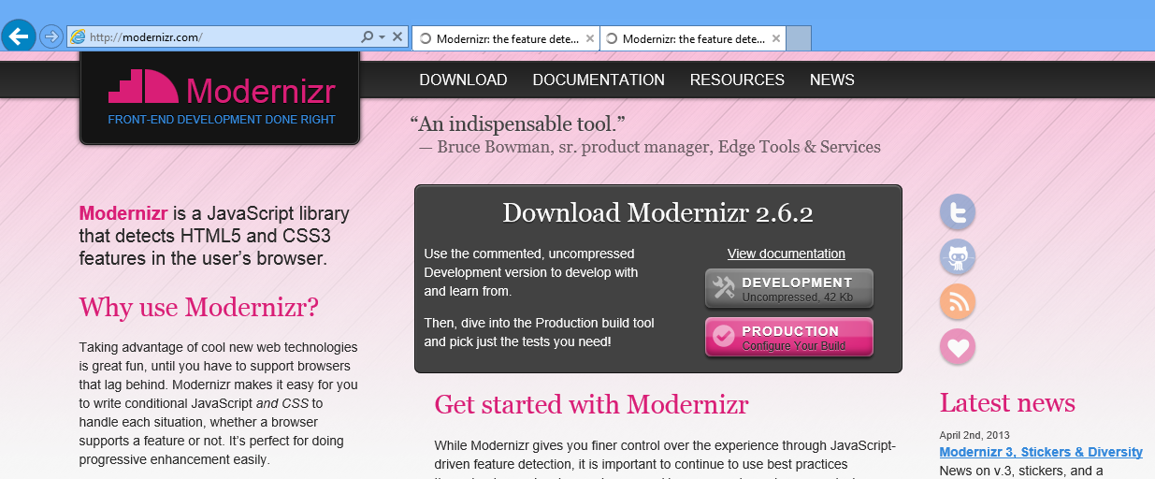
Detecting HTML – 5

Slide 32
DOM Selection
Traditional DOM Selection
HTML-5 DOM Selection

Slide 33
New Input Elements
color month url
datalist number week
date datetime datetime-local
email range search
tel time

Slide 34
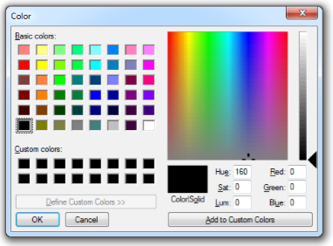
Color
<input type=“color”>

Slide 35
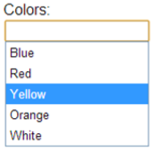
Datalist
<label for=“colors-box”>Colors</label><br />
<input id=“colors-box” list=“colors” />
<datalist id=“colors”>
<option type=“Blue”/>
<option type=“Red”/>
<option type=“Yellow”/>
<option type=“Orange”/>
<option type=“White”/>
</datalist>

Slide 36
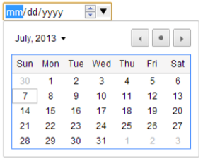
Date
<input type=“date”>

Slide 37

Time
<input type=“time”>

Slide 38
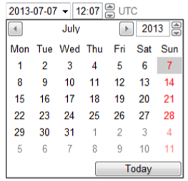
Datetime
<input type=“datetime”>

Slide 39
Datetime-local
<input type=“datetime-local”>

Slide 40
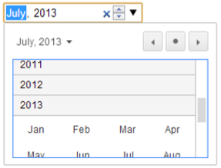
Month
<input type=“month” />

Slide 41
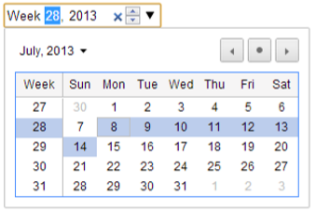
Week
<input type=“week” />

Slide 42
Email, URL and Telephone
<input type=“email” />
<input type=“url” />
<input type=“tel” />

Slide 43
Range
<input type=“range” />

Slide 44

Number
<input type=“number” />

Slide 45

Search
<input type=“search” />

Slide 46
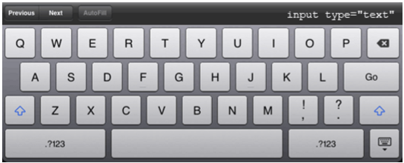
Soft Keyboard – Text

Slide 47
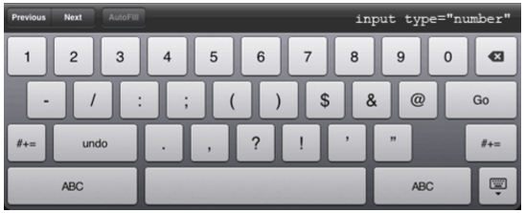
Soft Keyboard – Number

Slide 48
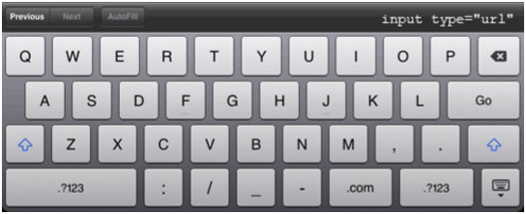
Soft Keyboard – URL

Slide 49
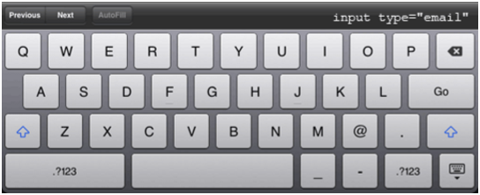
Soft Keyboard – EMail

Slide 50
Soft Keyboard – EMail

Slide 51
Native Validation Rules
required
<input type=“text” required value=“” />
required = true when the textbox is empty.

Slide 52
Native Validation Rules
url
<input type=“url” required value=“blue bird” />
true when the value does not match with the specified type.

Slide 53
Native Validation Rules
pattern
<input type=“text” pattern=“/^[A-z]+$/” value=“1234567” />
true when the value does not match with the specified regular expression in a pattern attribute.

Slide 54
Native Validation Rules
Range underflow, overflow and step
<input type=“range” max=“50” step=“5” min=“5” value=“0” />
true when the range element’s value is smaller than the min attribute.
true when the range element’s value is higher than the max attribute.
true when the range element’s value is impossible given the step value.

Slide 55
HTML-5 Media
Media Element
Supported Media Types
+

Slide 56
Native Video Formats
WebM (VP8 & 9)
H.264 (MP4)
Ogg Theora

Slide 57

Native Audio Formats
WebM
AAC
WAV
MP3
Ogg Vorbis
Ogg Opus

Slide 58
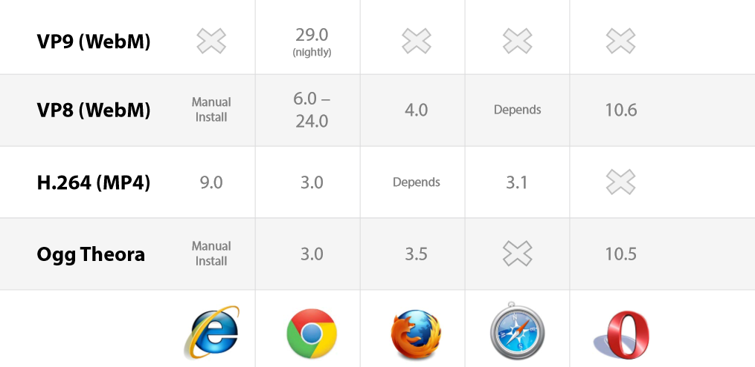
Native Media Support

Slide 59
Canvas
Canvas Element
JavaScript
API
+

Slide 60
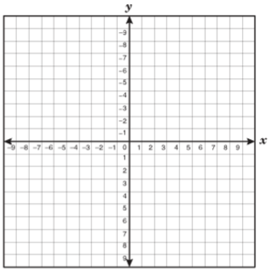
How Does Canvas Work?

Slide 61
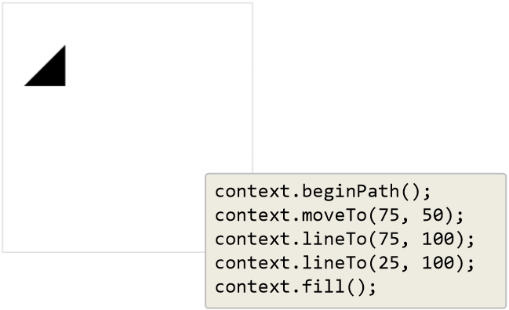
For Example

Slide 62
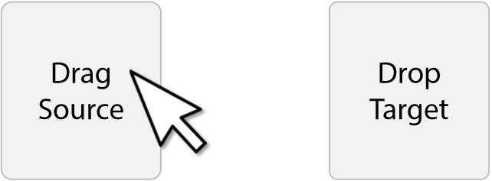
Drag and Drop
You must Cancel the default behavior to all the drop operations.

Slide 63
Events Occurrence during Drag and Drop
Drag Source
Drop Target
dragstart
dragenter
dragover
drag
dragleave
dragend
drop

Slide 64
Scalable Vector Graphics – SVG
It’s a key part of HTML 5
An alternative to Canvas in HTML 5
SVG is used to define vector-based graphics for the Web
SVG defines the graphics in XML format
SVG graphics do NOT lose any quality if they are zoomed or resized
Every element and every attribute in SVG files can be animated
SVG is a W3C recommendation

Slide 65
Advantages of using SVG
SVG images can be created and edited with any text editor
SVG images can be searched, indexed, scripted, and compressed
SVG images are scalable
SVG images can be printed with high quality at any resolution
SVG images are zoomable (and the image can be zoomed without degradation)

Slide 66
Difference between Canvas and SVG
Canvas | SVG [Scalable Vector Graphics]
Pixel-based (canvas is essentially an image element with a drawing API) | Object Model-based (SVG elements are similar to HTML elements)
Single HTML element similar to <img> in behavior | Multiple graphical elements which become part of the DOM
Visual presentation created and modified programmatically through script | Visual presentation created with markup and modified by CSS or programmatically through script
Event model/user interaction is coarse -- at the canvas element only; interactions must be manually programmed from mouse coordinates | Event model/user interaction is object-based at the level of primitive graphic elements -- lines, rectangles, paths

Slide 67
SSE – Server-Sent Events
New API in HTML 5
Used for One-Way Communication [Server-To-Client]
No more Explicit Polling for server side updates
Server is now capable of sending updates to the clients using SSE
Examples -:
Facebook/Twitter Updates
Up – To – Date Stock Price
News Feed
Cricket Score Cards

Slide 68

SSE – Browser Support

Slide 69
SSE – Events
You can use different Events of SSE API
onopen –
When Connection to the server is opened
onmessage –
When a message is received from the server
onerror –
When an error occurs during the communication

Slide 70
XMLHttpRequest – Level – 2 API
Used for transferring data between a client and a server
New features of Level – 2 are –
Cross – Origin Resource Sharing [CORS]
Progress Events for uploading
Support for uploading and downloading binary data
Performing File Upload
Performing CRUD operation

Slide 71
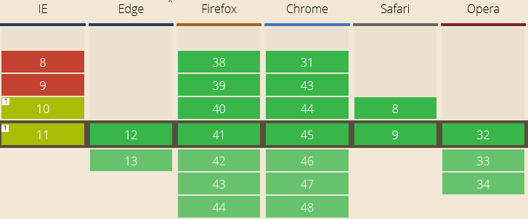
XMLHttpRequest – Level – 2 Browser Support

Slide 72
WebSocket API
WebSocket is a next-generation bidirectional [full Duplex] communication technology.
A persistent connection is established between client and server.
Once the connection is made, both client as well as server can start sending messages to each other.
WebSocket is a JavaScript API on client side.
To design the WebSocket on server side, we can make use of Microsoft.WebSockets API. You can download the same from NuGet package.

Slide 73
WebSocket API
Using socket.readyState attribute –
0 – indicates that the connection has not yet been established.
1 – indicates that the connection is established and communication is possible.
2 – indicates that the connection is going through the closing handshake.
3 – indicates that the connection has been closed or could not be opened.

Slide 74
WebSocket API
WebSocket Events –
open – this event fires when socket connection is established successfully.
message – this event fires when client receive the message from server.
error – this event fires when there is an error during communication.
close – this event fires when socket connection is closed.
WebSocket Methods –
send – this method is used for transmitting the data
close – this method is used close any existing connection to the server

Slide 75
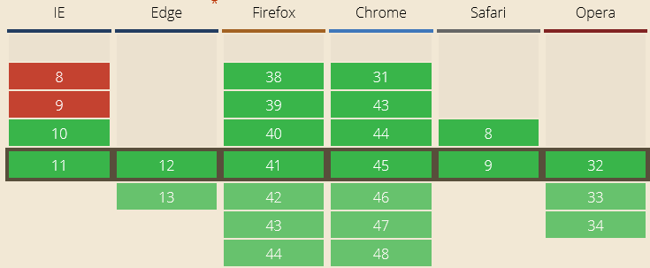
WebSocket API – Browser Support

Slide 76
Notification API
The Notification API is used to display notifications to the user on desktop computers and mobile devices
Different properties supported by Notification API are –
title – the title of the notification
Body – the body string of the notification
Icon – the URL of the image to be displayed as icon of the notification
tag – the ID of the notification
Silent – no vibrations, no sound should be issued regardless of the device settings.

Slide 77
Notification API
Notification Methods –
requestPermission() – request the permission to display the notification from the user.
Permissions could be granted/denied
close() – to close the notifications programmatically.
Notification Events –
onclick – it gets triggered each time when the user clicks the notification.
onerror – it gets triggered each time when notification encounters an error.

Slide 78
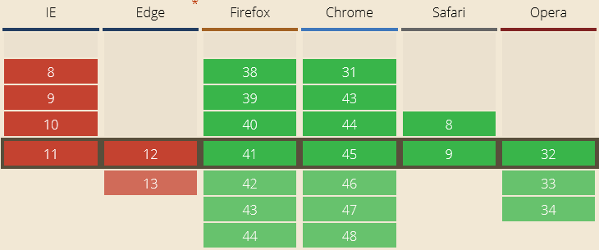
Notification API – Browser Support

